Slide 1
The Sea Floor
Physical Geology

Slide 2
Three major topographic units of the Ocean floor
  Continental margins (Active and Passive)
    Active margins
    Passive margins
  Ocean basin floor
  3. Mid-ocean ridge

Slide 3
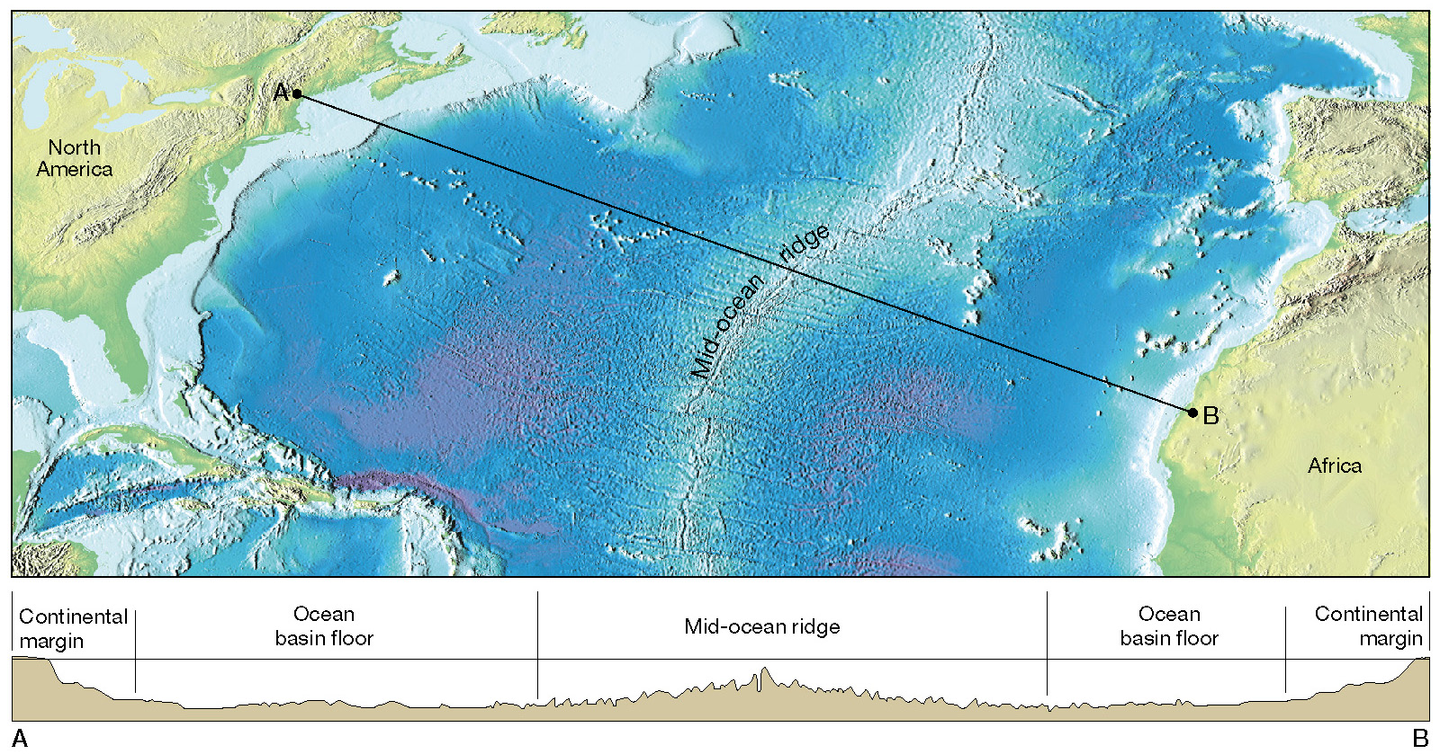
Major topographic divisions of the North Atlantic Ocean
Figure 9.14

Slide 4
I - Continental margins
Passive continental margins
  Found along most coastal areas that surround the Atlantic Ocean
  Not associated with plate boundaries
    Experience little volcanism and
    Few earthquakes
    Wider sandy beaches

Slide 5
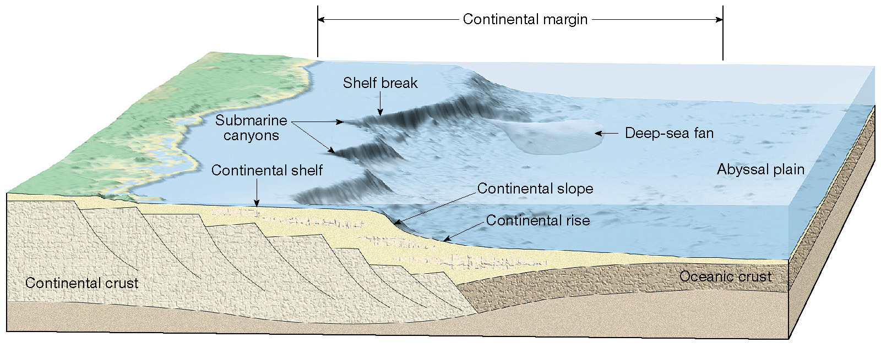
Features of a passive continental margin
Figure 13.9

Slide 6
Passive continental margins
Comprises three features:
  Continental Shelf
  Continental Slope
  Continental Rise

Slide 7
Passive continental margins
  Features comprising a passive continental margin
    1. Continental shelf
      Flooded extension of the continent
      Contains oil and important mineral deposits

Slide 8
Passive continental margins
  Features comprising a passive continental margin
    2. Continental slope
      Marks the seaward edge of the continental shelf
      Relatively steep structure
      Submarine canyons and turbidity currents

Slide 9
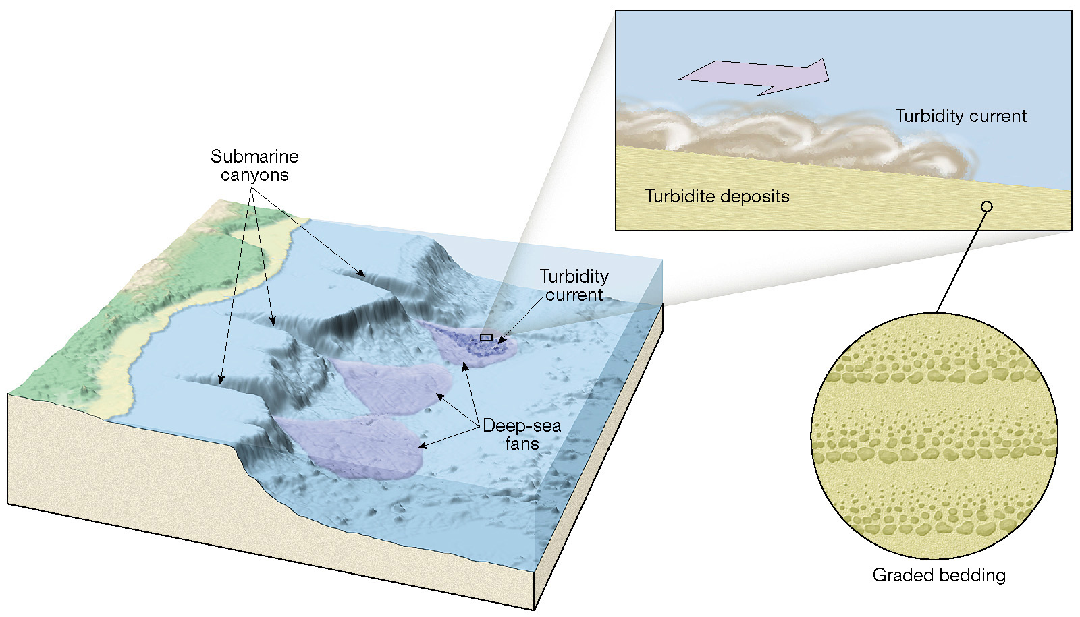
Turbidity currents
Figure 13.10

Slide 10
Continental margins
Passive continental margins
  Features comprising a passive continental margin
    3. Continental rise
      Found in regions where trenches are absent
      Continental slope merges into a more gradual incline – the continental rise
      Thick accumulation of sediment

Slide 11
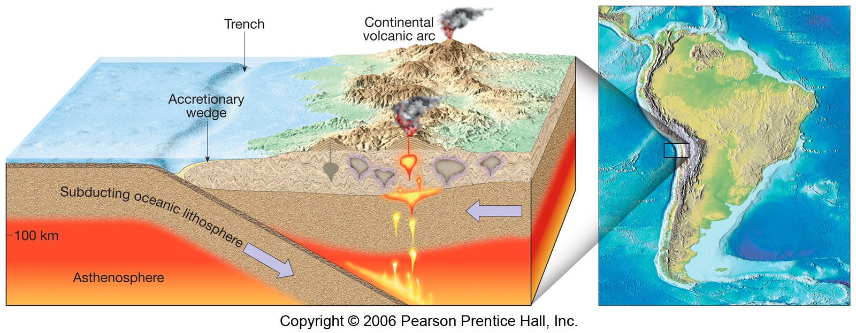
An active continental margin
Figure 9.18

Slide 12
Active continental margins
Deep-ocean trenches
  Long, relatively narrow features
  Deepest parts of ocean
  Most are located in the Pacific Ocean
  Sites where moving lithospheric plates plunge into the mantle
  Associated with volcanic activity
    Volcanic islands arcs (Japan)
    Continental volcanic arcs (Andes, Cascades mts)

Slide 13
II - Ocean basin floor
Abyssal plains
  Likely the most level places on Earth
  Sites of thick accumulations of sediment
  Found in all oceans
Seamounts and guyots
  Isolated volcanic peaks
  Many form near oceanic ridges

Slide 14
Ocean basin floor
Seamounts and guyots
  May emerge as an island
  May sink and form flat-topped seamounts called guyots or tablemounts

Slide 15
III - Mid-ocean ridge
Mid-ocean ridge
Characterized by An elevated position
Extensive faulting
Numerous volcanic structures that have developed on newly formed crust

Slide 16
Mid-ocean ridge
  Along the axis of some segments are deep down faulted structures called rift valleys
  Consist of layer upon layer of basaltic rocks that have been faulted and uplifted
  Mid-Atlantic Ridge has been studied more thoroughly than any other ridge system

Slide 17
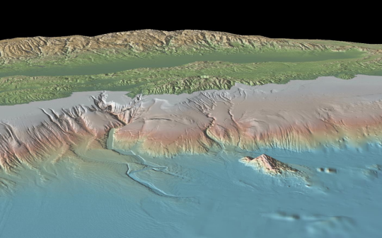
Identify the numbered ocean features
1
4
2
3
6
5

Slide 18
Identify the numbered ocean features
1. Continental Shelf
4. Continental Margin
2. Continental Slope
3. Continental Rise
6. Seamount
5. Abyssal Plain

Slide 19
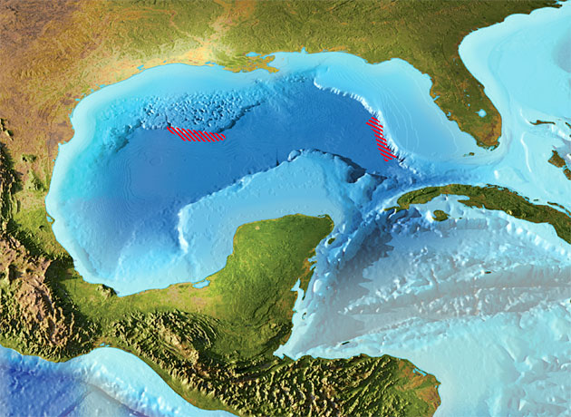
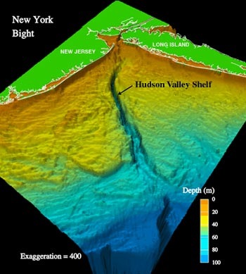
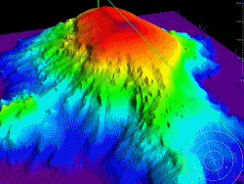
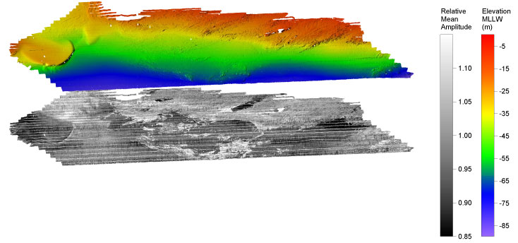

Slide 20
